Slide 1


Slide 2

Unlock insights on any data
FDN-04
Eron Kelly
General Manager, SQL Server Marketing
锐普PPT论坛chinakui首发：www.rapidbbs.cn

Slide 3
Trends driving IT pressures & opportunities
Devices
Apps
Big data
Cloud
>50%
More than half of information workers across 17 countries report using 3+ devices for work
25% one quarter of external app implementation spending will be on mobility, cloud, analytics, & social, by 2016
26B By 2020, IoT will include 26B units, creating large quantities of data & generating >$300B in revenue for IoT suppliers
~50% nearly half of total IT spend will be cloud-related by 2020
锐普PPT论坛chinakui首发：www.rapidbbs.cn
Devices: “Info Workers Will Erase Boundary Between enterprise And Consumer Technologies.” Forrester Research. August 30, 2012
Apps: Gartner: “Predicts 2013: Business Impact of Technology Drives the Futures Application Services Market.” Nov. 21, 2012
Big data: Paraphrased from "The Impact of the Internet of Things on Data Centers." Gartner Research, Feb 27, 2014
Cloud: “Prepare For 2020: Transform Your IT Infrastructure And Operations Practice.” Forrester Research. Oct. 24, 2012

Slide 4
What differentiates today’s thriving companies?
锐普PPT论坛chinakui首发：www.rapidbbs.cn
Data.

Slide 5
Technology innovation accelerates value
锐普PPT论坛chinakui首发：www.rapidbbs.cn
Machine learning
In-memory
Any data
Operational reporting
Internet of Things
Ad hoc analysis
Dashboards
ETL
OLAP
Hadoop
Transactional systems
Value
Enterprise data warehouse
Complex implementations
Spreadmarts
Siloed data
Innovation

Slide 6
Help customers seize their data dividend
锐普PPT论坛chinakui首发：www.rapidbbs.cn
Capture a $1.6 trillion data dividend from data investments by 2017 worldwide.
$158B
Productivity
$486B
Diverse data
New analytics
More people
Operations
@
Speed
$235B
Innovations
$235B
Customer-facing
Source: IDC & Microsoft, April 2014

Slide 7

Microsoft’s approach delivers data dividends
锐普PPT论坛chinakui首发：www.rapidbbs.cn
An end-to-end platform for any data and everyone
Business questions
and problems
Actionable
results
Transform + analyze
Visualize + decide
Data
Capture + manage
Microsoft data platform

Slide 8

The Microsoft data platform
锐普PPT论坛chinakui首发：www.rapidbbs.cn
Visualize + decide
Applications
Reports
Dashboards
Ask
Mobile
Transform + analyze
Visualize + decide
Transform + analyze
Visualize + decide
Data
Data
Transform + analyze
Orchestration
Information management
Complex Event Processing
Query
Prediction
Collect + manage
Capture + manage
Capture + manage
Relational
Non-relational
NoSQL
Streaming
Internal & external
{ }
✓

Slide 9

Capture + manage
锐普PPT论坛chinakui首发：www.rapidbbs.cn
Collect and manage diverse data types with breakthrough speed
…across a data continuum
Scale your platform quickly to meet changing demands
Transform + analyze
Visualize + decide
Data
Capture any data: structured, unstructured, and streaming
Capture + manage
On-premises, cloud, and appliance data sources
Breakthrough In-memory performance

Slide 10
SQL Server 2014 breakthrough in-memory
锐普PPT论坛chinakui首发：www.rapidbbs.cn
In-memory built into core engine
No need to rewrite existing apps
Use the hardware you have today
Faster apps & insights
Uses industry-standard hardware
Best-of-breed in-memory by workload
Up to 30X
Up to 100X
90%
OLTP performance gains
Faster star join queries
Disk space savings

Slide 11
DEMO Breakthrough In-memory performance
锐普PPT论坛chinakui首发：www.rapidbbs.cn

Slide 12


“Data is the lifeblood of our company.“
STAN ORLOWSKI DIRECTOR OF DATABASE STRUCTURES
NASDAQ OMX
Compressed data by 75%, saving 500TB of disk space
Reduced query time from days to hours
Cut storage footprint by 50%
锐普PPT论坛chinakui首发：www.rapidbbs.cn

Slide 13
SQL Server 2014 built-in hybrid technologies
锐普PPT论坛chinakui首发：www.rapidbbs.cn
Easy deployment to Azure
Built with Azure
SQL Server pre-built Azure VMs
Hybrid AlwaysOn with Azure VMs
Backup to Azure Storage
Simplified & globally backed DR
Integrated backup to Azure
…from an enterprise-grade cloud

Slide 14

Azure Data Services for Modern App Design
锐普PPT论坛chinakui首发：www.rapidbbs.cn
Relational and NoSQL database options
Right data, right service , no tradeoffs
App scale without hiring additional staff
Near-zero administration
Enterprise-grade capabilities
Key value and blob storage
Sophisticated search experiences
Enterprise-cloud data protection
DB
{ }
Websites
SQL database
DocumentDB
Search
Tables
HDInsight

Slide 15
DEMO Data services for the modern app
锐普PPT论坛chinakui首发：www.rapidbbs.cn
Pablo Castro
Partner Architect
Microsoft

Slide 16


“Meets strict security and compliance requirements.”
John Schlesinger Chief Enterprise Architect
TEMENOS, SWITZERLAND
With T24 on Azure, Temenos can more easily grow in emerging markets
Azure provides deployment agility not found in on-premises applications
On-demand scalability enables T24 customers to meet close-of-business deadlines
锐普PPT论坛chinakui首发：www.rapidbbs.cn

Slide 17
The Microsoft data platform
锐普PPT论坛chinakui首发：www.rapidbbs.cn
Visualize + decide
Applications
Reports
Dashboards
Ask
Mobile
Transform + analyze
Transform + analyze
Visualize + decide
Transform + analyze
Data
Transform + analyze
Information management
Information management
Complex Event Processing
Orchestration
Complex Event Processing
Orchestration
Query
Query
Prediction
Prediction
Capture + manage
Collect + manage
Capture + manage
NoSQL
NoSQL
Streaming
Relational
Streaming
Relational
Non-relational
Non-relational
Internal & external
{ }
Internal & external
{ }
✓
✓

Slide 18
Transform + analyze
锐普PPT论坛chinakui首发：www.rapidbbs.cn
Transform and analyze data for anyone to access anywhere
Connect, combine, and orchestrate any data
Transform + analyze
Visualize + decide
Data
Unleash complex real-time event processing
Capture + manage
Build and test predictive models
Supported by on-premises, cloud, and appliance data sources

Slide 19
Analytics Platform System for Big Data
锐普PPT论坛chinakui首发：www.rapidbbs.cn
Pre-built and performance-tuned
Turnkey Big Data appliance
Linear scale-out to PBs of data
Up to 100x performance increase
MPP design and In-memory columnstore
Dedicated Hadoop region
PolyBase for single query across all data
Select...
Results set
PolyBase
MPP
SQL Server
Hadoop
Non-relational
Relational

Slide 20


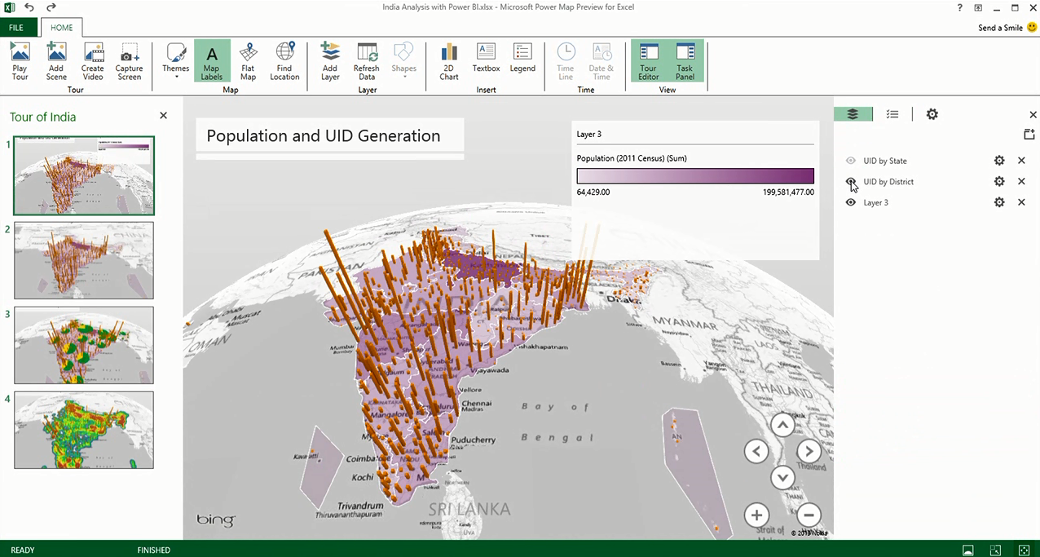

Announcing: Azure Stream Analytics
锐普PPT论坛chinakui首发：www.rapidbbs.cn
Managed real-time analytics
Real-time stream processing
Near infinite cloud scale
Mission-critical reliability and scale
Rapid development
Smart Phones
Slates/ Tablets
Servers
ATM
Security
Stream Analytics
POS Terminals
Kinect
PCs/ Laptops
Vending Machines
Specialized Devices
Kiosks
Automation Devices
Digital Signs
Thin Clients
Self Checkout Stations
Handhelds
Point of Service Devices
Diagnostic Equipment
Logic Controllers
Remote Medical Monitors

Slide 21

Announcing Azure Data Factory
锐普PPT论坛chinakui首发：www.rapidbbs.cn
Manage from a single pane of glass
Connect & collect
Compose and orchestrate data services at scale
Publish for analytics
Set data production policy
Identify and debug errors
No SQL
Blob
MapReduce
BI & analytics
VM
Hive
Trusted data
DB
Pig
C#
Stored Procedures

Slide 22
Azure Machine Learning
锐普PPT论坛chinakui首发：www.rapidbbs.cn
The power of machine learning to predict future trends or behavior
Data
Microsoft Azure Machine Learning
Results & iterations
ML Studio
Cloud
Data factory
HDInsight
SQL Server VM
SQL Database
DocumentDB
Blobs & tables
Microsoft Azure Portal
Workspace
Publish in minutes
Local
Web
Desktop files
Excel spreadsheet
Other data files
Devices
Applications
Dashboards
Storage space
Business problem
Modeling
Deployment
Business value

Slide 23
DEMO Real-time analytics and machine learning
锐普PPT论坛chinakui首发：www.rapidbbs.cn
Sanjay Soni
Sr. Technical Product Marketing Manager
Microsoft

Slide 24





Final Retail Demo Architecture
锐普PPT论坛chinakui首发：www.rapidbbs.cn
Event / Data producers
Ingest
Transform
Long-term storage
Predictive Analytics
Presentation and action
Event
Hubs
Visualizations
and insights
Web logs
Azure Data Factory
Stream Analytics
Azure SQL Database & Azure Storage (blobs)
Azure Machine
Learning
Web dashboards
In-Store Activity
Intelligent Systems Services
Stream Analytics
Social Data
Batch Analytics
Mobile devices
Azure Data Factory
Compose and orchestrate data services at scale
Manage data from a single pane of glass
Stream Analytics
Managed near real-time stream processing and analytics at cloud scale
Rapid development and mission critical reliability
Azure ML
Fully-managed cloud service to bring you agile & accessible, predictive analytics
Azure market place – one-stop shop for Premium Data and Applications
Power BI
Self service analytics for all your data
Data discovery and natural language exploration to enable data culture

Slide 25


“Our challenge is to get information to people in a way that helps them make their journeys better, faster, and less stressful”
MICHAEL GILBERT CHIEF TECHNOLOGY OFFICER TRANSPORT OF LONDON
Built on Azure, supports a growing 2.3 million hits per day
Real-time data feeds support data-driven applications to relieve traffic congestion
Avoided building a new physical IT infrastructure, saving millions of £
锐普PPT论坛chinakui首发：www.rapidbbs.cn

Slide 26
The Microsoft data platform
锐普PPT论坛chinakui首发：www.rapidbbs.cn
Visualize + decide
Visualize + decide
Reports
Reports
Dashboards
Dashboards
Ask
Ask
Mobile
Applications
Mobile
Applications
Transform + analyze
Transform + analyze
Visualize + decide
Transform + analyze
Data
Transform + analyze
Information management
Information management
Complex Event Processing
Orchestration
Complex Event Processing
Orchestration
Query
Query
Prediction
Prediction
Capture + manage
Capture + manage
Relational
Non-relational
NoSQL
Streaming
Internal & external
{ }
✓

Slide 27

Visualize + decide
锐普PPT论坛chinakui首发：www.rapidbbs.cn
Transform + analyze
Discover, explore, and combine any data type or size, regardless of location
Visualize + decide
Data
Ask questions of data to visualize, analyze, and forecast
Capture + manage
Make faster decisions, share broadly,
and access insights on any device

Slide 28
锐普PPT论坛chinakui首发：www.rapidbbs.cn
Excel as the BI tool for everyone
Power BI for collaboration & new experiences
1 Billion Microsoft Office users
1 in 4 enterprise customers on Office 365
Discover
Analyze
Visualize
Share
Ask
Access
Q&A
Scalable, Manageable, Trusted

Slide 29
DEMO Unlock insights with advanced visualizations
锐普PPT论坛chinakui首发：www.rapidbbs.cn
Sanjay Soni
Sr. Technical Product Marketing Manager
Microsoft

Slide 30


“BI that’s as Fast, Friendly, and Reliable as the Bank Itself."
Bruce Rioch Head of Business Information and Customer Systems METRO BANK, UNITED KINGDOM
Dashboards to give executives and colleagues highly visual, at-a-glance statistics on mobile app engagement
Uses Power BI to drive millions of transactions into balance sheets and profit-and-loss statements
Executives and colleagues can view and collaborate on BI data with Power BI
锐普PPT论坛chinakui首发：www.rapidbbs.cn

Slide 31
An expanding data platform
锐普PPT论坛chinakui首发：www.rapidbbs.cn
Visualize + decide
Analytics Platform System AU2
SQL Server 2014
SQL Server on Azure VMs w/ DW & OLTP images, auto-HA
Azure SQL Database updates
Azure DocumentDB
Azure HDInsight w/ Hbase & Hadoop 2.4
Azure Machine Learning
Azure Search
Power BI
Power Map
Power Query
Applications
Reports
Dashboards
Ask
Mobile
Transform + analyze
Orchestration
Information management
Complex Event Processing
Query
Prediction
Capture + manage
Relational
Non-relational
NoSQL
Streaming
Internal & external
{ }
✓

Slide 32
Help your organization seize its data dividend
锐普PPT论坛chinakui首发：www.rapidbbs.cn
…become a data hero
Transform + analyze
Visualize + decide
Data
Capture + manage

Slide 33

锐普PPT论坛chinakui首发：www.rapidbbs.cn
© 2014 Microsoft Corporation. All rights reserved. Microsoft, Windows, Windows Vista and other product names are or may be registered trademarks and/or trademarks in the U.S. and/or other countries.
The information herein is for informational purposes only and represents the current view of Microsoft Corporation as of the date of this presentation. Because Microsoft must respond to changing market
conditions, it should not be interpreted to be a commitment on the part of Microsoft, and Microsoft cannot guarantee the accuracy of any information provided after the date of this presentation.
MICROSOFT MAKES NO WARRANTIES, EXPRESS, IMPLIED OR STATUTORY, AS TO THE INFORMATION IN THIS PRESENTATION.

